Slide 1
Credit Default Risk Prediction using Machine Learning
Team 10
Akshay Oza & Tianying Chu
Data Science and Big Data
-Fall 2020

Slide 2
Table of Contents
01
02
03
04
Problem Domain
Data & EDA
Model Training & Evaluation
Recommendations & Future Work

Slide 3
01
Problem Domain

Slide 4
Outstanding personal loan debt triples from 49 billion dollars in 2010 to 156 billion dollars, as of Q3 2019.
Notes:
In recent years, people tend to spend more now and borrow against future income. A statistic shows that outstanding personal loan debt triples from 49 billion dollars in 2010 to 156 billion dollars, as of Q3 2019. These numbers make us interested in the problem of predicting credit default.

Slide 5
Problem Domain
Task
Performance
·Predict whether a client has payment difficulties
·Pick out the most important factors related to credit default
·Use recall to evaluate performance
·Interpret feature importance via SHAP/LIME explainer
Experience
Value
·Applicants’ personal background
·Past loan activities
·Increased efficiency and accuracy
·Save financial costs due to default
Notes:
We have defined our problem domain as follows. We have 2 tasks. One is to predict … The other is to pick out …
We learn from … at application time and … such as installment payments and credit card balance
We evaluate the performance of first task by models’ recall score and interpret …
Our work can … for financial institutes to figure out people who will default and ...

Slide 6
02
Data & Exploratory Data Analysis
Notes:
Let’s see the datasets we used.

Slide 7
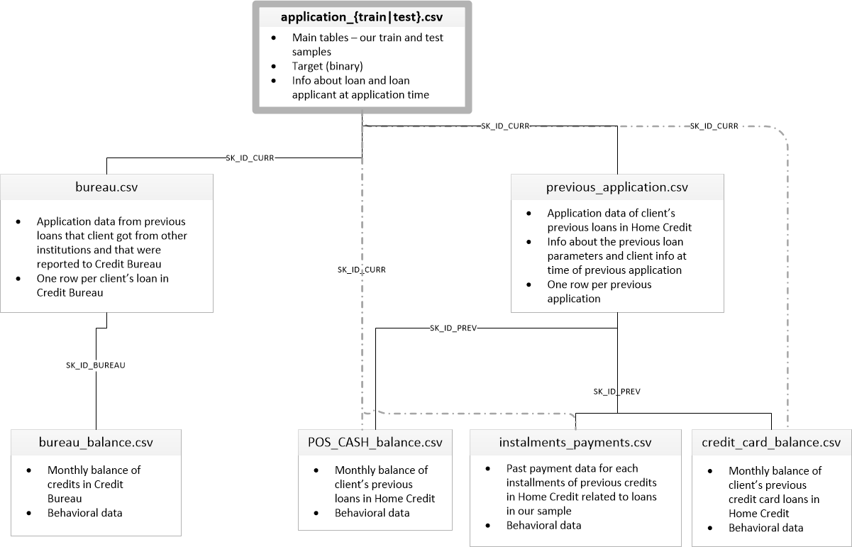
Data - Home Credit Default Risk Data
Notes:
It is from a financial institution called Home Credit. The file at top, application_train, is the one we will focus on. It includes the information of current application. Each row in this file will be the unit of prediction. We also use previous_application, installment_payments, and bureau file with some preprocessing.

Slide 8
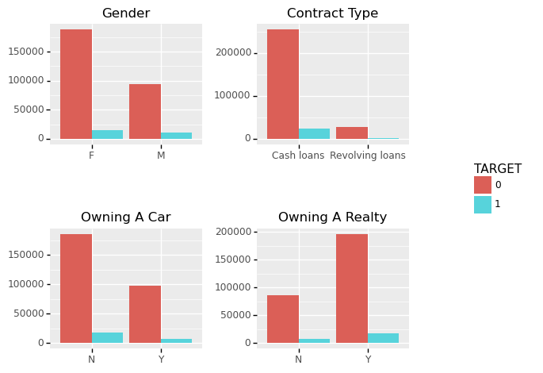
EDA - Applicants’ Characteristics
Notes:
In the application_train file, we have learn the characteristics of applicants. For example, most applicants are female. They sign a cash loan contract. Most of them do not have a car but have a realty. We find such similar characteristics in both defaulter and non-defaulter. Even the number of non-defaulter is extremely larger than the number of defaulter.

Slide 9
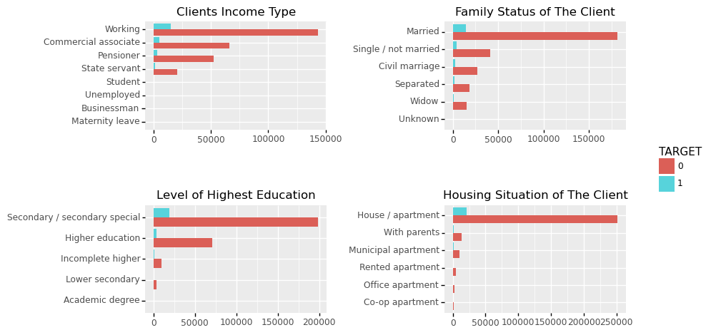
EDA - Applicants’ Characteristics
Notes:
Here are some other features. Working people, commercial associate, pensioner and state servant are the most 4 common income type.
Most of them are married and live in a house or an apartment.
The level of highest education is either secondary special or higher education.

Slide 10
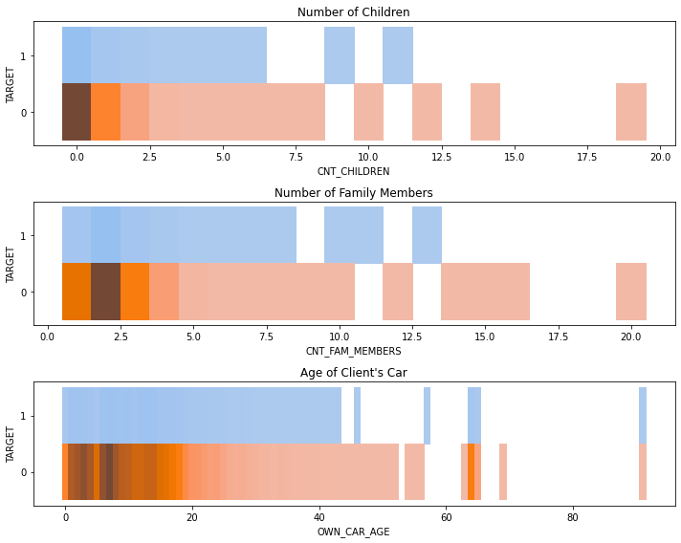
EDA - Applicants’ Characteristics
Notes:
And we learn about their family background as well.

Slide 11
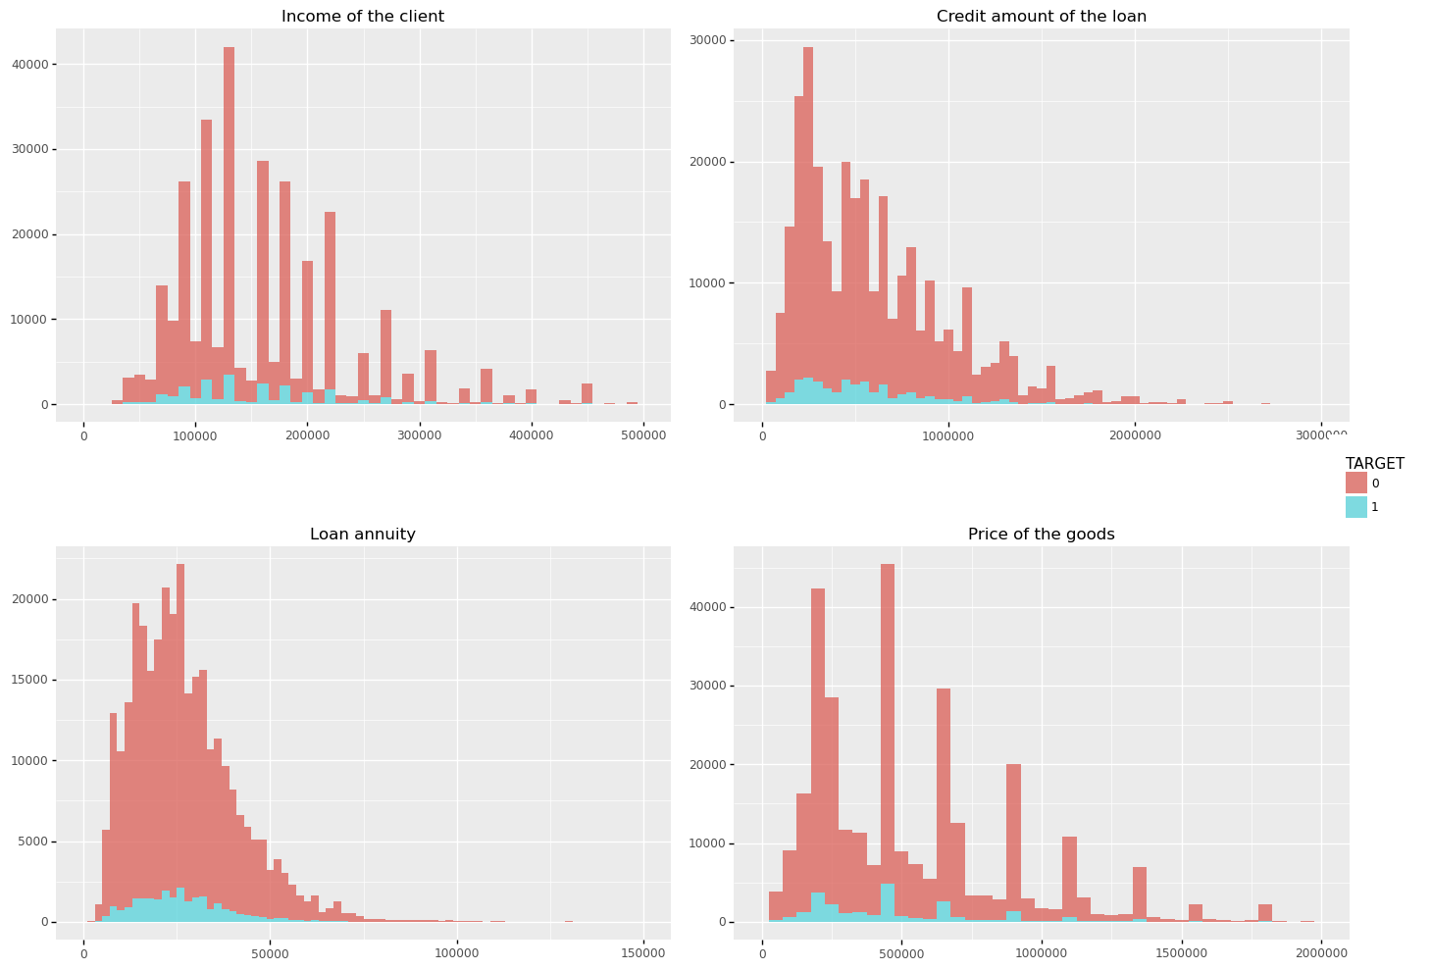
EDA - Loan Activities
Notes:
Another type of interesting features are about loan activities. We assume they may be important to predict credit default. Here are the distributions of client’s income, credit amount of the loan, annuity, and price of the goods. They are all right skewed. And we can observe some bins are higher than their neighbors.

Slide 12
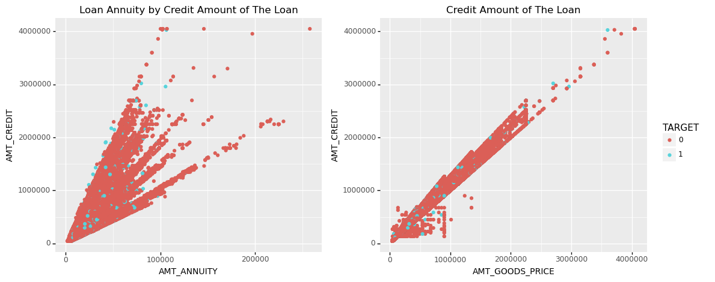
EDA - Loan Activities
Notes:
We even find positive correlations between loan annuity and credit amount, and price of goods and credit amount.

Slide 13
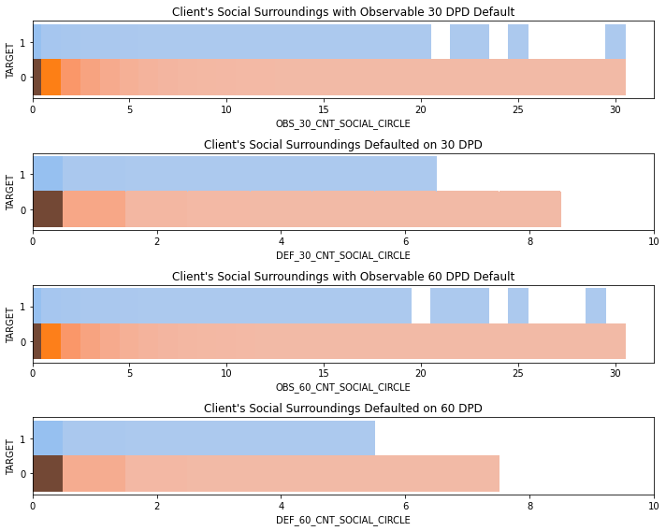
EDA - Loan Activities
Notes:
Also, we think about whether the clients’ social surroundings will affect credit default.

Slide 14
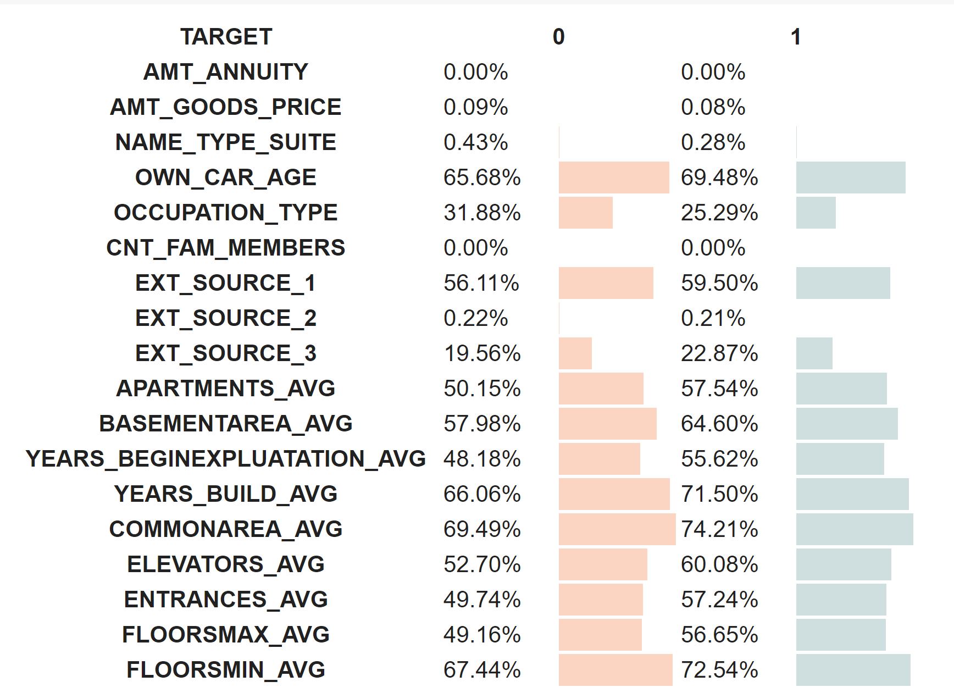
EDA - Missing Values
Notes:
Finally, we check the missing values in our datasets. For columns like AMT_ANNUITY, AMT_GOODS_PRICE and CNT_FAM_MEMBERS, they have only a few missing values. So we will simply impute them. Others like OCCUPATION_TYPE and EXT_SOURCEs, they have a high proportion of missing values. We will consider dropping them.

Slide 15
Data Preprocessing
- Imputation
application_train.csv
previous_application.csv
installment_payments.csv
bureau.csv
·More than 10-20% ‘Nan’ values
- remove those columns
·Less than 10% missing data
- use mean or mode to impute
Notes:
After visualizing our datasets, we go through 4 steps to prepare the data for training.
The first step is imputation. As mentioned before, for columns with high proportion of missing, we’ll remove them. The others will be imputed by mean or mode. It applies to all the four files above.

Slide 16
Data Preprocessing
- Grouping & Aggregation
previous_application.csv
installment_payments.csv
bureau.csv
·Grouped by `PREV_SK_ID_CURR`
·Numerical Columns
- aggregated by mean
·Categorical Columns
- OHE & aggregated by sum
Notes:
For the 3 file recording past loan activities, we group them by a unique identifier and aggregate numerical columns by mean. For categorical ones, we first use OHE and then aggregate by sum. We then merge these files with application_train file.

Slide 17
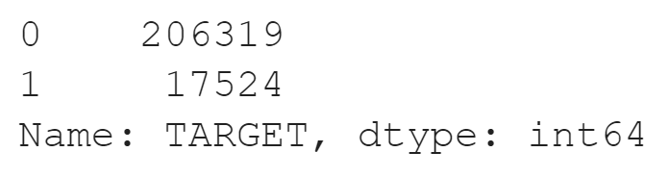
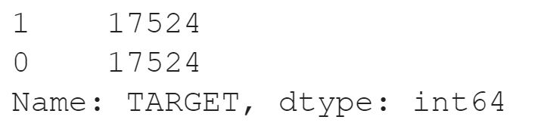
Data Preprocessing
- Downsampling
Before downsampling
After downsampling
·Highly imbalanced
·Requires large computational memory
35,048 rows

Slide 18
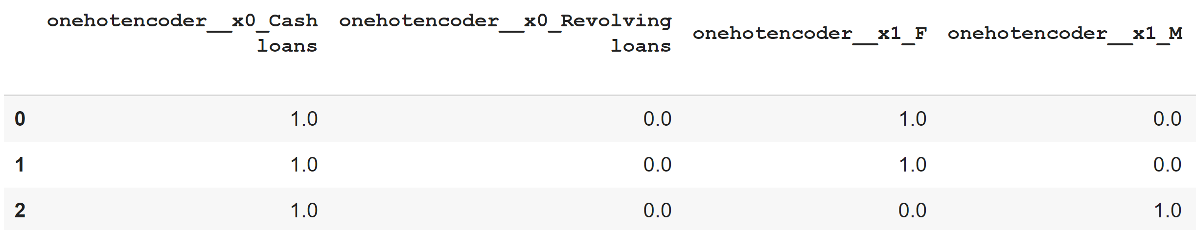
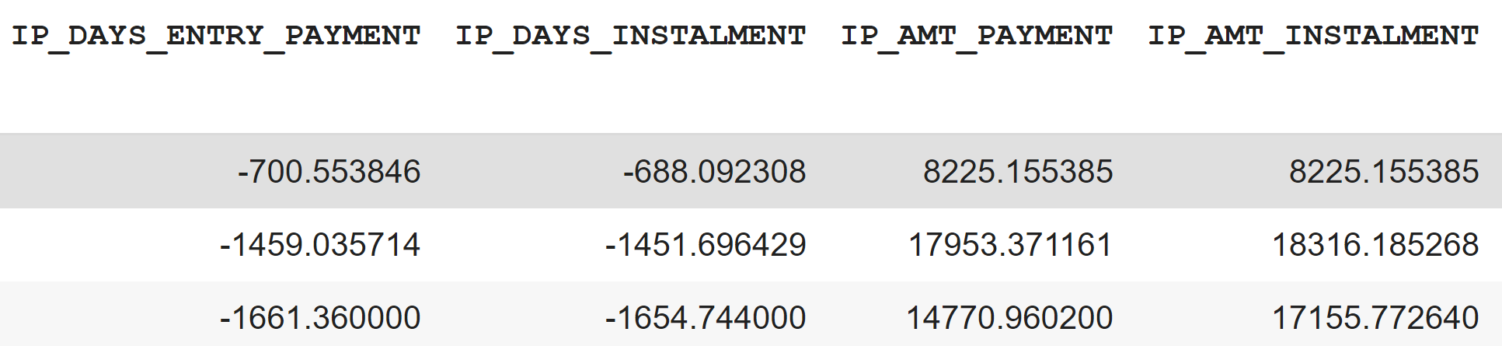
Data Preprocessing
- Column Transformation
Categorical columns
Numeric columns
307 columns

Slide 19
03
Model Training & Evaluation

Slide 20
Process
Model Training and Hyperparameter Tuning
Model Selection and Feature Importance
Final Prediction and LIME Results
We train our model and perform hyperparameter tuning using Randomized Search CV with 5 fold Cross Validation
We use Precision-Recall Curve to assess our models and select the one that gives us best recall rate. We then use SHAP to understand important features
We use our final model to predict on the test data and use LIME to interpret the results in detail

Slide 21
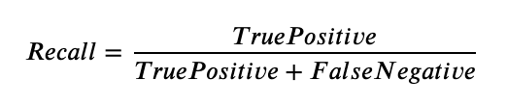
Why Recall ?
In our case, false negatives i.e. predicting an applicant will not default when actually they do would be more costly than flagging someone as an applicant that might default. Thus Recall let’s us choose the model that minimizes these false negatives the most and assess the sensitivity of our model.

Slide 22
Machine Learning Models for Training
Naive Bayes
Logistic Regression
Perceptron
Decision Trees
Random Forest
Light Gradient Boosting Machine

Slide 23
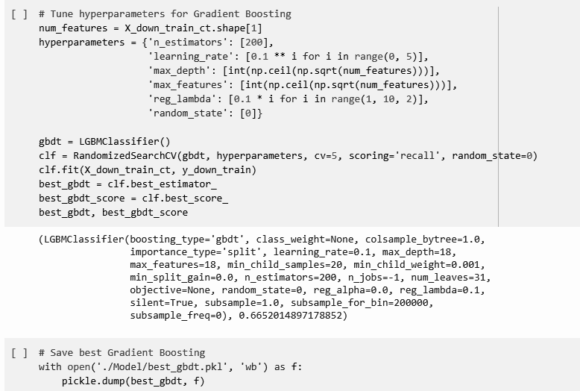
Model Training and Hyperparameter Tuning - Example for GBM
We defined hyper-parameters
We run random search with 5 fold Cross Validation
Save the best model
Notes:
We can see in our code that the training and tuning consisted of 3 major parts. First we defined all our hyperparameters. Nest we ran a randomized search cv along with 5 fold cross validation to find the best combination of hyperparameters for our model. Then we save the model as a pickle file. This process was repeated for all six models.

Slide 24
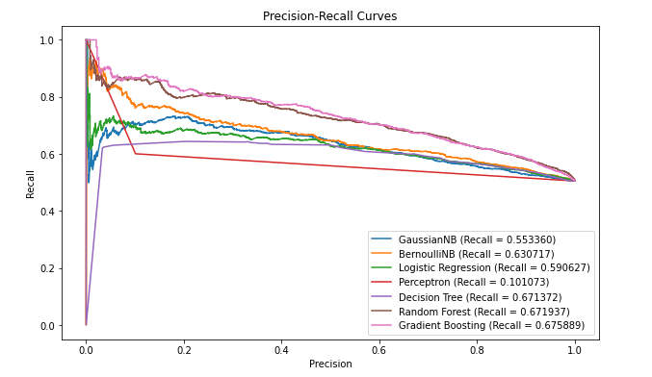
Model Selection- Precision Recall Curve
Notes:
From the precision recall curve, we can observe that our top three models are Decision Trees, Randon Forest and Gradient Boosting Machine. GBM has the highest recall rate of 0.675 while still preserving a high precision rate. Thus we decide to choose Gradient Boosting Machine as our final model. Although Random Forest gives us a similar result we observed that our GBM trains faster for a large number of trees as compared to Random Forest. Since we would like a model that is able to provide us fast real world prediction, we decided to choose Gradient Boosting Machine over Random Forest

Slide 25
But what exactly it means for the decision maker ?

Slide 26
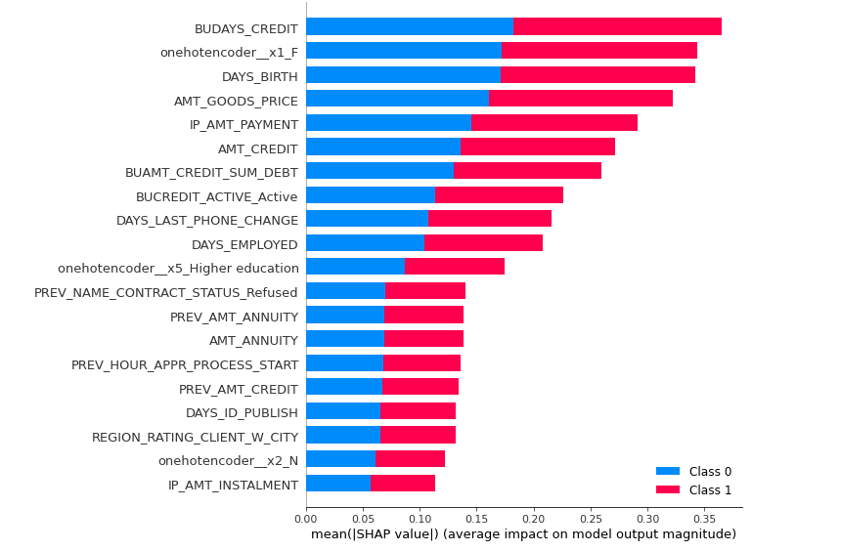
Feature Importance using SHAP- Summary Plot
SHAP Values: Average of marginal contribution over all the permutation of feature values

Slide 27
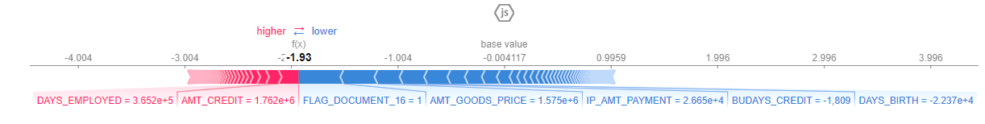
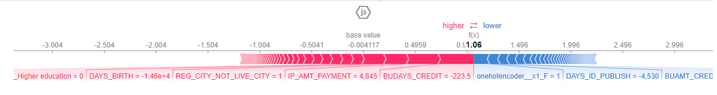
Feature Importance using SHAP- Local Interpretability
Applicant classified as ‘0’ or ‘non-defaulter’
Applicant classified as ‘1’ or ‘defaulter’

Slide 28
Final Prediction on Test Data
Model : Gradient Boosting Machine
Recall - 0.649

Slide 29
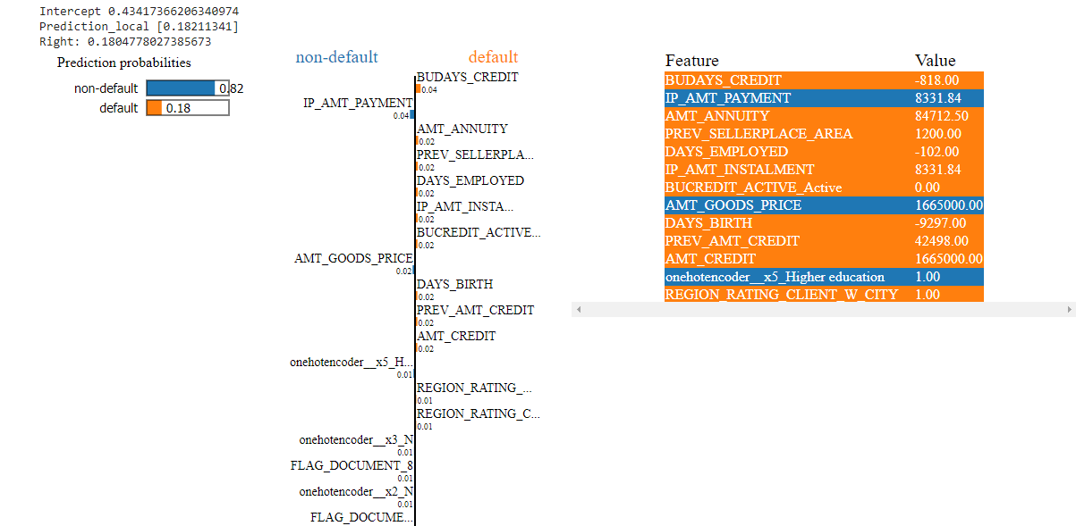
Locally Interpretable Model-Agnostic Explanation- LIME
Use LIME for more detailed explanation on classification result

Slide 30
04
Recommendations,Limitations and Future Work

Slide 31
Our final GBM model gives us a recall rate of 0.649 on the test data and we recommend using this model to predict the credit risk for the applicants
The model can be used only for applications which have previous application and credit history data with the financial institutions
Use the model as a flagging system
We highly recommend using LIME/ SHAP to interpret the results from the model
Use different feature engineering techniques
Use more complex models like Neural Networks and compare the results
Use upsampling and more hyperparameter configurations with big data infrastructure like Spark/Hadoop
Fairness metrics such as False Discovery Rate should be used to achieve fairness across genders present in our dataset.
Notes:
The recall rate from the model is not very high. So we would recommend that our model should be used more as a flagging system rather than being used to make the final decision. Once an applicant is flagged, the experts can take a look at the shap force plot for the particular applicant and decide whether the features classifying the applicant as 'defaulter' are important enough according to their expertise to not provide a loan to that particular applicant

Slide 32
Thank you!

